Slide 1

Object Oriented Programming
Lec # 1: introduction

Slide 2
Some Rules
Raise your hand before asking any question
Don’t miss a class
No retakes (except for Mid or Final Exam)
Don’t “sleep” in the class
You might miss a quiz
Avoid using mobile phone in the class
Above all, whatever you do, please do not disturb others

Slide 3
Attendance Policy
Attendance will be taken at the beginning of the lecture (after first 10 mins)
80% attendance is mandatory
Students coming late (within 30 mins) will be marked as late. Will be marked absent after that.
2 late arrivals are equal to an absent

Slide 4
How to be successful in this course??
Be interactive, ask questions
Participate in the lecture, relax, and learn
Practice coding
Do try to solve the sample problems
Ask questions asap and get help when needed
Start on assignments early
Talk to your peers
Share ideas, not code

Slide 5

Dishonesty, Plagiarism
All parties involved in any kind of cheating in (Quizzes, Assignments & Projects) will get ZERO in that exam
Plagiarism threshold 25-30% in assignments
Plagiarism in midterm/ final exam may result in F grade in the course
Habitual cases will be awarded F

Slide 6
Evaluation Breakdown
Absolute Grading

Slide 7
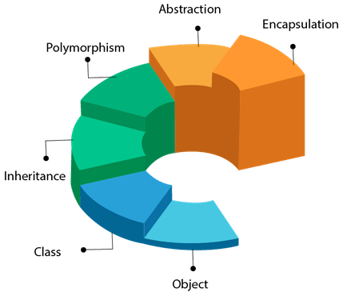
Course objective
In simple words, you will learn how to write object-oriented programs

Slide 8
Course Outline
List of Topics
Memory Layout, pointers, dynamic memory allocation, stack vs. heap, pointer arithmetic, pointer vs. array, multidimensional pointers, pointer types, char* pointers, alias to pointers (*&)
Recursion, recursion for patterns and problem solving
Introduction to object-oriented design, structures (struct keyword), access specifiers, member functions
Introduction to classes (class keyword), constructors vs. destructors, copy constructor, overloading constructors, this pointer for function call resolution.
constant vs non-constant members, static data members and functions and Inline functions vs. macros
Function overloading, introduction to operator overloading, unary and binary operators overloading, member vs. global functions for operator overloading, stream insertion and extraction operators overloading (friend functions)

Slide 9
Course Outline
List of Topics
Identifying classes and defining relationships, introduction to composition (Association & Aggregation), separating interface from implementation
Introduction to inheritance, types of inheritance, function overriding, function overriding vs. overloading, single vs. multiple inheritance
Introduction to polymorphism, virtual vs. non-virtual functions, abstract vs. concrete classes
Introduction to streams and file handling, files modes, ASCII vs binary file handling, sequential vs. random file reading and writing
Introduction to templates, template functions and template classes, C++-20 advance concept

Slide 10
Reference Material
Textbook:
Tony Gaddis, Starting Out with C++ from Control Structures to Objects (8th Edition) Publisher: Pearson; 8 edition
Reference Book:
Paul Deitel, Harvey Deitel "C++ How to Program" 10th Edition
Walter Savitch "Problem Solving with C++" 10th Edition
D. S. Malik "C++ Programming: From Problem Analysis to Program Design" 8th Edition

Slide 11
What is Object Oriented Programming?
Procedural programs are organized as a series of steps or instructions that execute one by one; OOP provides another way to organize your programs
Object oriented programs are organized as groups of objects that have certain attributes and can take certain actions.
When the program executes these objects
interact with each other.

Slide 12


Some Examples of Objects
Car
Attributes:
balance
Behavior
Deposit
Withdraw
Check balance
Attributes:
Gas in tank
Mileage
Behavior
Accelerate
Brake
Load fuel
Check fuel
Bank Account

Slide 13


Objects Interact with each other
Get Loan
Bank
Customer
Bank Account
Deduct Zakat
Deposit
Withdraw

Slide 14
Why do we need Object Oriented Programming?
Due to the limitations of procedural programming (even after structuring into functions and files)
No matter how well structured the program is, as the size of the program increases it becomes excessively complex

Slide 15
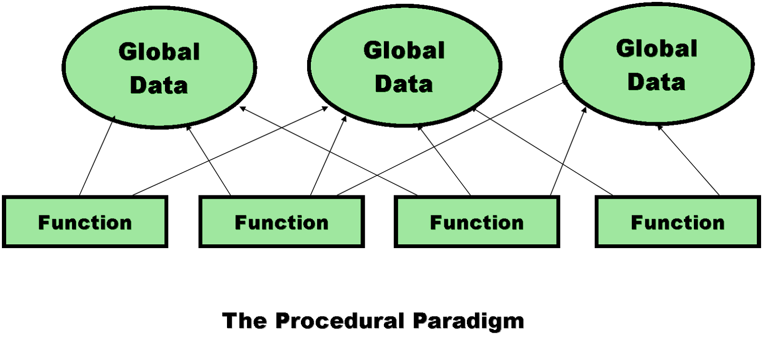
Limitations of procedural programming
1. Unrestricted Access
Global data can be accessed by any function in the program
Program structure
Difficult to conceptualize
Difficult to modify

Slide 16
Limitations of procedural programming
2. Poor Real-World Modeling
Procedural programming arranges data and functions separately.
In the real world we deal with objects such as people and cars. Such objects aren’t like data and they aren’t like functions
Complex real-world objects have both attributes and behavior
OOP Programs
Easy to conceptualize
Easy to modify

